Slide 1

Arabic Handwritten Characters Recognizer
Arabization

Slide 2
Team Members
Mohamed Salah Esmaiel
Omar Mohamed Khater
Mahmoud Essam Othman
Wasila Mohamed
Mohamed Ahmed Ibrahim AbouElsafa
Ayman Kamel Elsalamony
Waleed Hamdy

Slide 3
Project Overview
Our project's aim is to program the computer to identify hand-written alphabets via matrix operations. Each alphabet image contains 32*32 pixels, and we create a matrix using these pixels. By multiply the matrix to several sample matrixes, the pixels are converted into a deep neural network. And finally, we employ adam optimizer method so that the computer can predict the highest possibility of the alphabet written.
Keyword: Deep learning, ANN, Feature Extraction, CNN , Machine Recognition, natural and physical sciences, image data, image processing

Slide 4
Domain Background
Character recognition is one of the most important research fields of image processing and pattern recognition. Character recognition is generally known as Optical Character Recognition (OCR).OCR is the process of electronic translation of handwritten images or typewritten text into machine editable text. It becomes very difficult if there are lots of paper based information on companies and offices. Because they want to manage a huge volume of documents and records. Computers can work much faster and more efficiently than human.

Slide 5
Problem Statement
The main objective of this research is to find a new solution for handwritten text recognition of different fonts and styles by improving the design structure of the traditional Artificial Neural Network (ANN). ANNs have been successfully applied to pattern recognition, association and classification, forecast studies, and control applications, to name a few. The recognition results of such text or handwritten materials are then fed into Optical Character Recognition (OCR) as an electronic translation of images of handwritten, typewritten or printed text into machine-editable text.

Slide 6
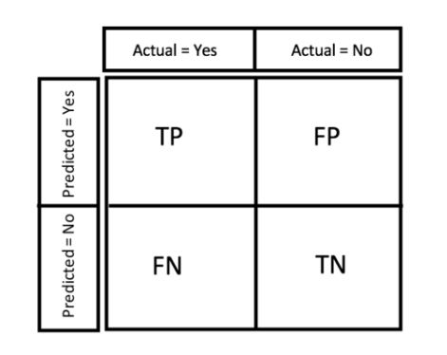

Metrics
Generating a confusion matrix, for summarizing the performance of a classification algorithm.

Slide 7
Analysis
Data Exploration
The Arabic (Alef - yeh) Handwritten Data contains capitalized handwritten alphabet images (Alef - yeh) in size of 32x32 pixels. Each alphabet in the image is centered at 20x20 pixel box. There are 372451 images in total, or approximately 14325 images for each of the alphabet, in the data file. The dataset contains 2 .csv files with information necessary to make a prediction

Slide 8
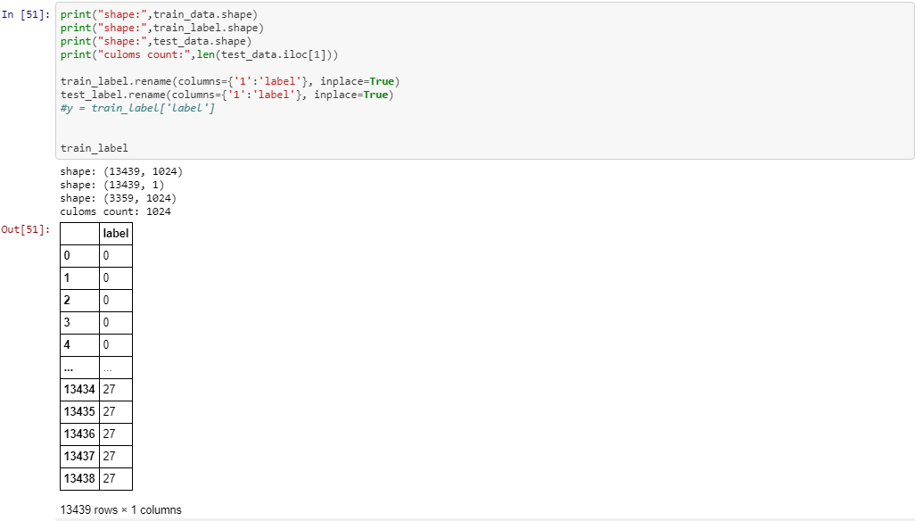
Cont.
The images are taken from NIST (https://www.nist.gov/srd/nist-special-database-19)

Slide 9
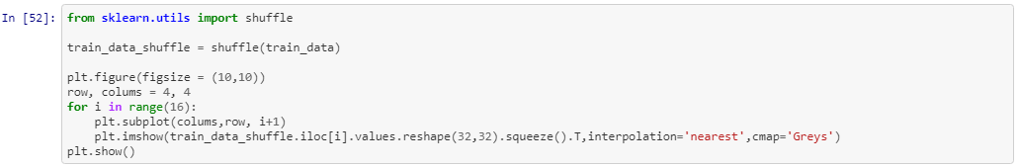
Exploratory Visualization
In the code below, we first use the shuffle() method to randomize the data (the original one is sorted from Alef to Yeh, and it is not machine-friendly). Then, we extract the label, the number indicating which letter is this row representing.

Slide 10
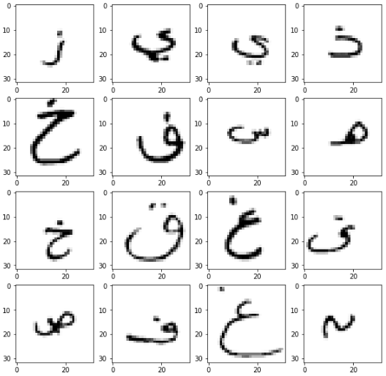
Cont.

Slide 11
Algorithms and Techniques
This classifier is a Convolution Neural Network, which is the state-of-art algorithm for most image processing tasks, including classification. It needs a large amount of training data compared to other approaches, fortunately, the dataset is big enough the algorithm outputs an assigned probability for each class. The following parameters can be tuned to optimize the classifier: I. Training parameters • Training length (number of epochs) • Batch size (How many images to look at once during a single training step) • Learning rate (how fast to learn, this can be dynamic) II. Neural network architecture • Number of layers • Layer type (convolutional, fully connected, or pooling)

Slide 12
Benchmark
As a kaggle data set, my benchmark model showed that the results were promising with a 98% classification accuracy rate on testing images.
I plan to work on improving the performance of handwritten character recognition. https://www.kaggle.com/chandanshinde/character-recognition-using-keras

Slide 13
Methodology
Data Preprocessing In order to achieve maximum efficiency, we need to preprocess the data before we feed it into the neural network. first, I split the data into training and test data then scale it; it's important to scale the data not to have a dominate variables as we know from the Euclidean distance concept. Once we got explore the dataset we preprocess it by: 1. Step 1: Import Libraries. First step is usually importing the libraries that will be needed in the program. ... 2. Step 2: Import the Dataset. ... 3. Step 3: Taking care of Missing Data in Dataset. ... 4. Step 4: Encoding categorical data. ... 5. Step 5: Splitting the Dataset into Training set and Test Set. ... 6. Step 6: Feature Scaling.

Slide 14
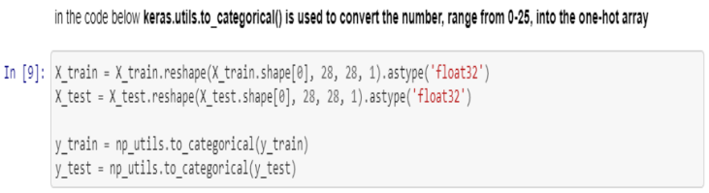
Cont.
In the code above, we first use the shuffle() method to randomize the data (the original one is sorted from Alef - yeh, and it is not machine-friendly). Then, we extract the label, the number indicating which letter is this row representing, from the raw data. keras.utils.to_categorical() is used to convert the number, range from 0-25, into the one-hot array.

Slide 15
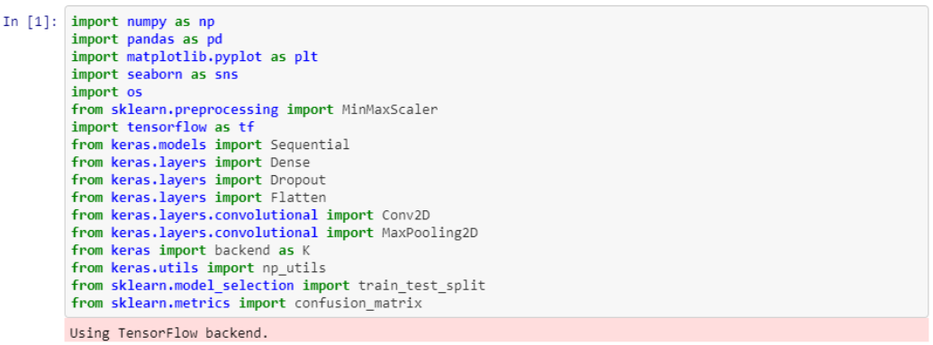
Implementation
1. Import libraries

Slide 16
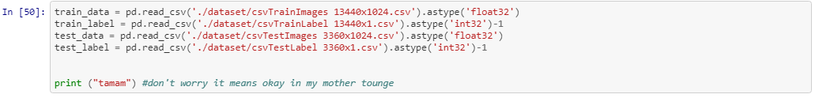
Cont.
2. Importing Dataset well, The Dataset contains capitalized handwritten alphabet images (Alef - yeh) in size of 32x32 pixels. Each alphabet in the image is centered at 20x20 pixel box. There are 16798 images in total, or approximately 598 images for each of the alphabet, in the data file.

Slide 17

Cont.
3.Data Exploration

Slide 18
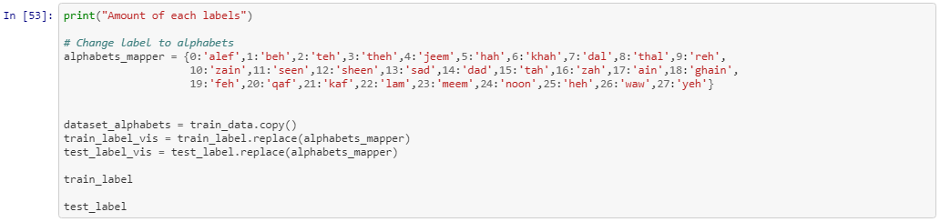
Cont.
Data Image visualization
changing labels to alphabets I'm filtering the data frame by label frequencies or characters now, using the famous groupby() method .

Slide 19
Cont.
Until we got a conclusion: -
train alef count: 479
test alef count: 119
each alphabit has 598 sample 479 for the training, and 119 for the testing.

Slide 20
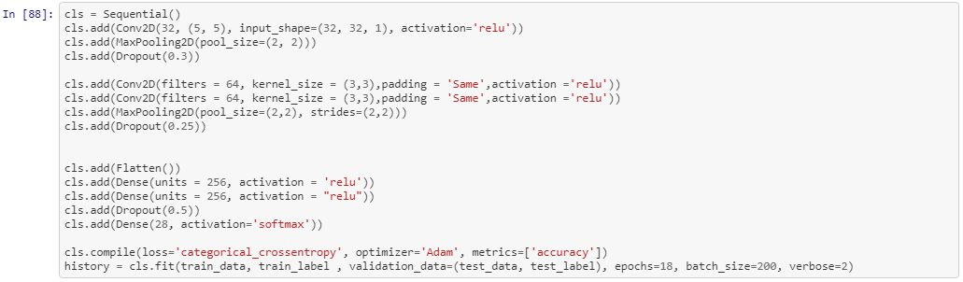
Cont.
4.Data preprocessing 5.Building and Training the model First, we build the model. Then, we use the fit() method to train the network

Slide 21
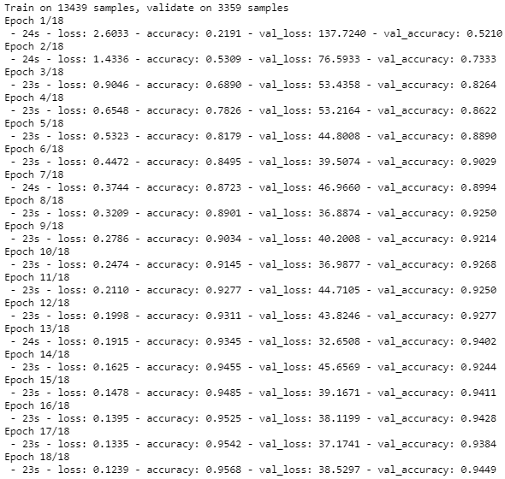
and here is what we got:

Slide 22
Refinement
As a kaggle data set, my benchmark model showed that the results werepromising with a 98% classification accuracy rate on testing images. I plan to work on improving the performance of handwritten character recognition. but Increasing the number of CNN layers and use convolutional, using max pooling and flatten, using relu and softmax activation function and Optimizing the CNN using Adam, all together did improve the accuracy
CNN Score: 0.9449240565299988

Slide 23
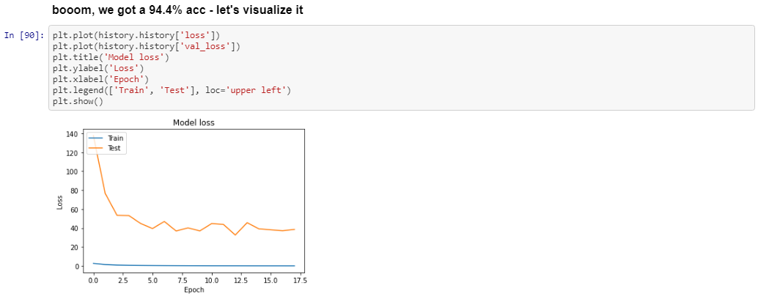
Cont.

Slide 24
Results
This model can detect Latin character in 32x32 photos
- The model generalizes well to unseen data it’s predicted thelabel perfectly.
- The model didn’t affect with small changes in the data, orto outliers because of scaling of the data between values 0 to 1.
- We can trust in the model because of it us a high accuracyafter fitting the Neural Network

Slide 25
Justification
After I train the Network I have an accuracy of 99.4% which is greater than the accuracy presented in the Benchmark model (98%). When I create the first model I get bad accuracy and try several times with different parameters, so I increased the epochs from 10 t0 18 also I increased the layer to make it deeper so that’s enough to have a good model. I changed the optimizer from the descent to Adam to get more high accuracy This architecture solves the proposed problem

Slide 26
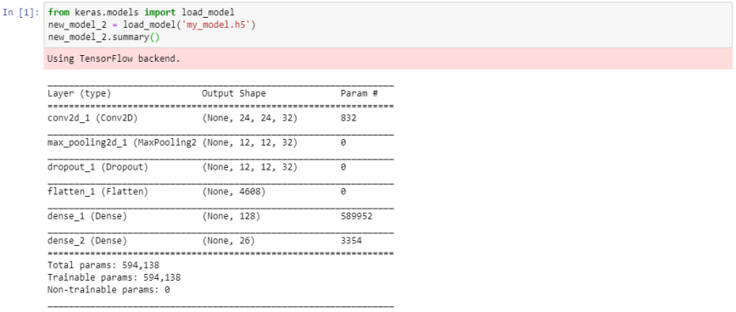
Conclusion
Free-Form Visualization

Slide 27
Reflection
The process used for this project can be summarized using the following steps: 1. An initial problem and relevant, public dataset were found 2. The dataset was downloaded and preprocessing 3. The benchmark model was created for the model 4. The classifier was trained using the data (multiple time, until a good set of parameters were found)

Slide 28
Improvement
It will be more useful to classify words or even paragraphs rather than characters (e.g. classify email spams)

Slide 29
Questions?

